Slide 1
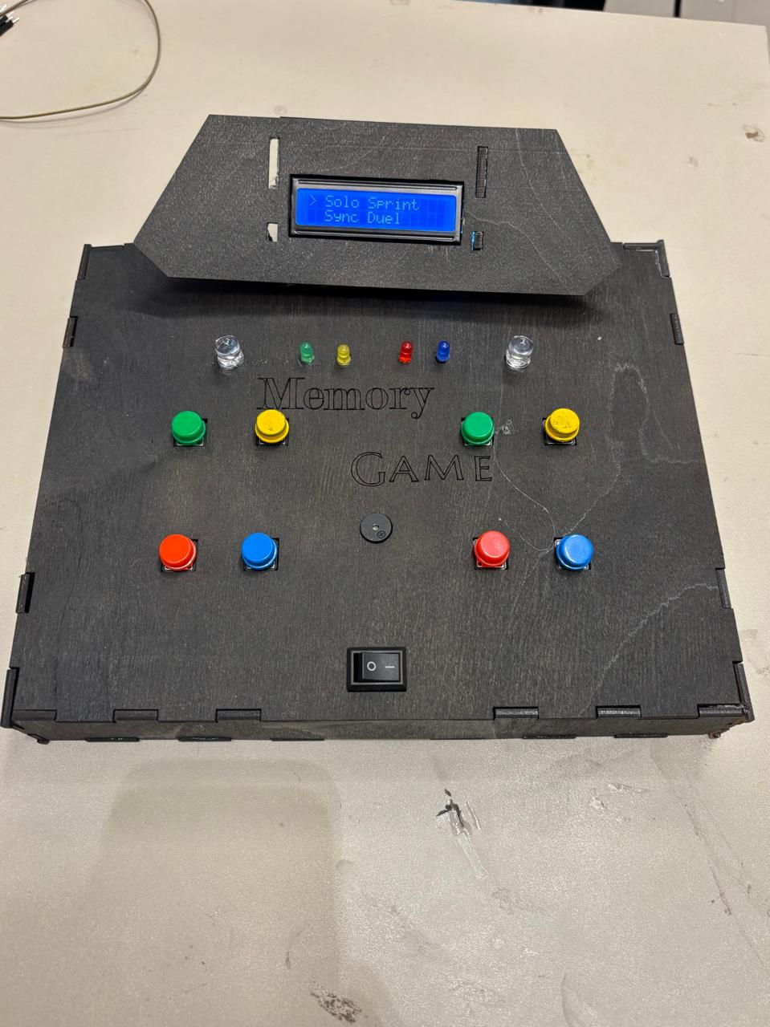
Microconsole : Multiplayer Memory Game
A microcontroller gaming console for memory and speed testing
Team leader: Yousef Ahmed Galal
Members:
Abdelrahman Taha Elsayed
Rawan Haytham anwar
Ahmed Osama Ibrahim

Slide 2
Introduction / Aim
This project implements a microcontroller-based gaming console that tests memory, reaction speed and competitive performance.
The system supports three gameplay modes:
Solo sprint
Synchronous duel
Challenger mode
It integrates real-time input handling, LED feedback, LCD interface and persistent storage.
The design focuses on:
Responsiveness (non-blocking using millis() )
Reliability (debouncing + timeout logic)
User experience (menu system + feedback)

Slide 3
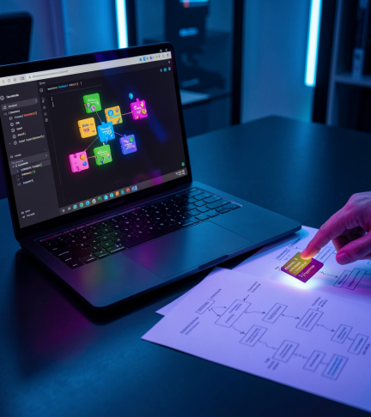
System Architecture

Slide 4
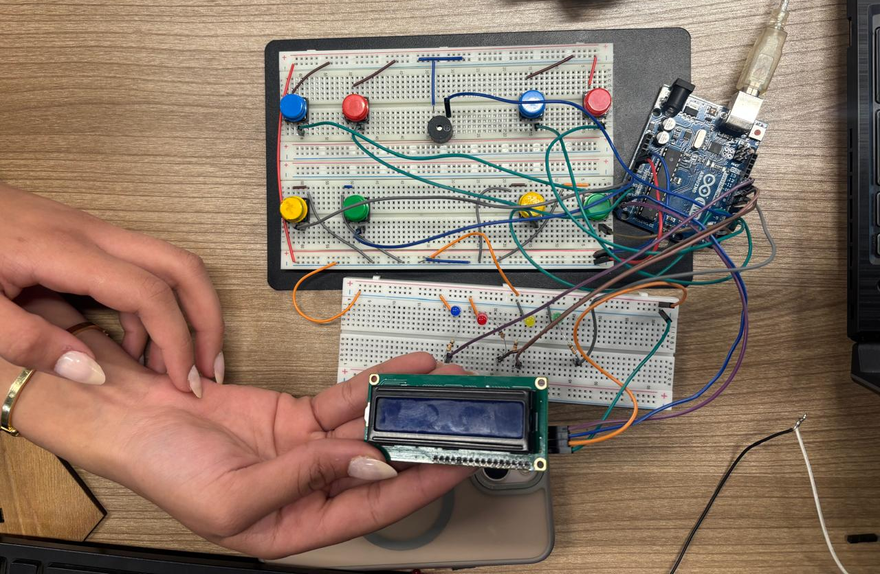
Hardware Components
8 push buttons (4 per player)
Micro controller (Arduino-based system)
4 LEDs for sequence display
I2C LCD for UI and scores
Passive buzzer for audio feedback
EEPROM for persistent leaderboard

Slide 5
Power and Pin Configuration
Powered via 2 3.7V battery cells
GPIO ports mapped efficiently:
Port D → Player 1 buttons + buzzer
Port C → Player 2 buttons
Port B → LEDs
Designed for low power consumption using sleep mode

Slide 6
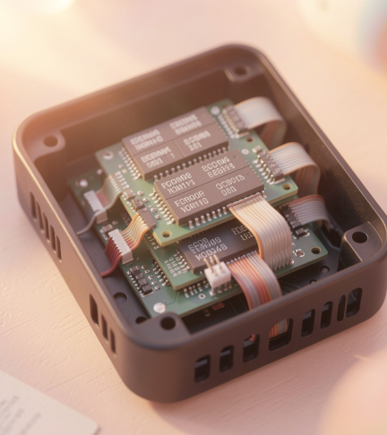
Firmware structure
Modular architecture using multiple .ino files:
Hardware layer (LEDs, Buttons, LCD, Buzzer, Memory)
Logic layer (Game Modes + State Machine)
Central control via:
main.ino
runStateMachine()
Non-blocking design using millis() instead of delay()

Slide 7

02
Peripherals Management

Slide 8
Input handling
8 buttons with software debouncing (50 ms)
Uses:
readButtons()
getLastButtonPressed()
Prevents:
Double input
Ghost triggering

Slide 9
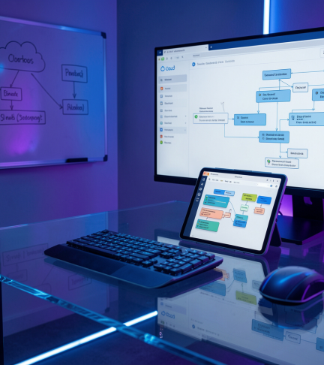
Display and audio
LCD:
Menu navigation
Real-time score display (no flickering using cursor updates)
Buzzer:
High tone → correct
Low tone → wrong
Special tone → game over

Slide 10
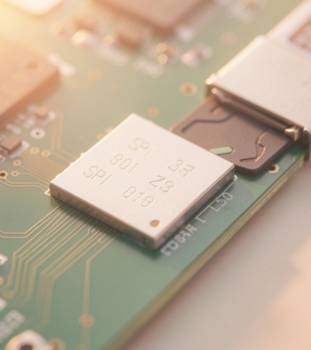
Storage interfaces
Data integrity ensured using:
Controlled writes
Structured memory addresses
EEPROM used to store top 5 high scores
Supports:
Save
Load
Reset leaderboard

Slide 11
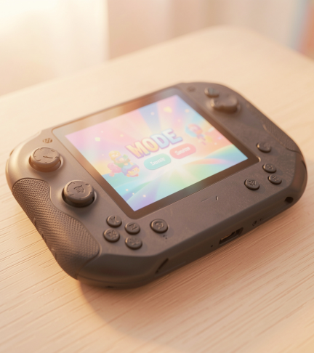
Gameplay Modes

Slide 12
Memory challenge (solo sprint)
Player repeats increasing LED sequences
Difficulty increases by:
Increasing sequence length
Decreasing LED display time
Game ends on:
Wrong input
Timeout

Slide 13
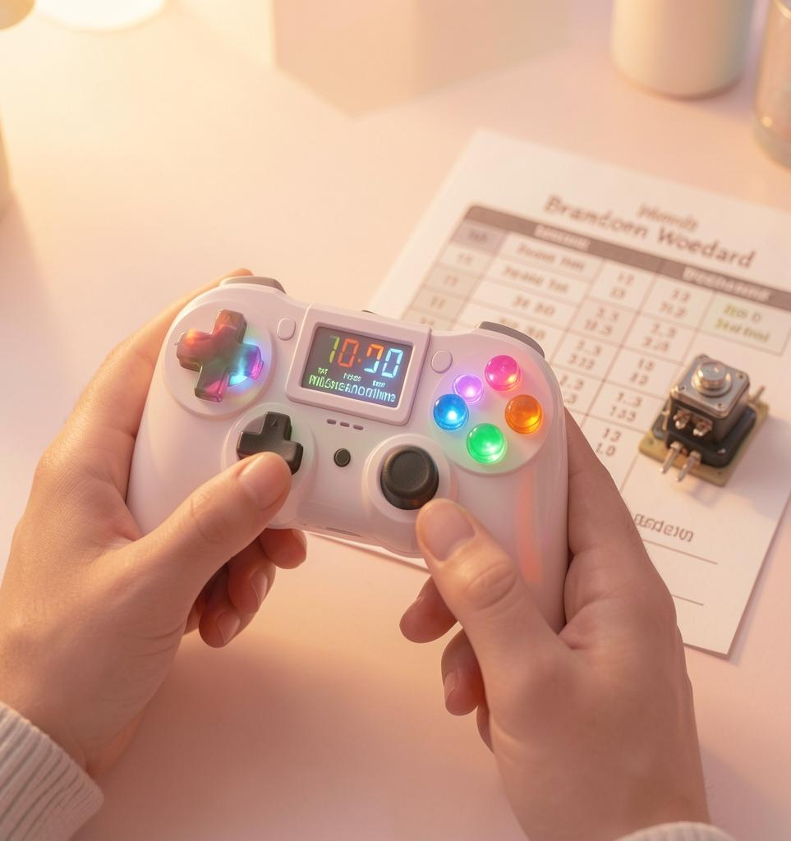
Speed competition (Duel)
Both players compete to replicate the sequence
System measures:
Accuracy
Reaction speed
Points awarded to fastest correct player

Slide 14
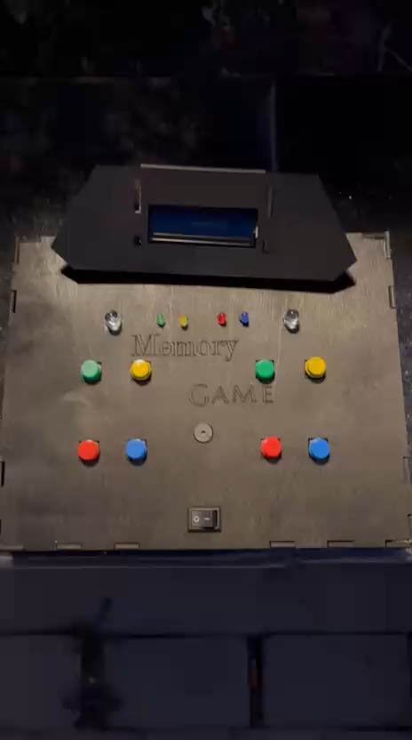
Challenger Mode
Player A enters a secret sequence
Player B attempts to replicate it
If Player B fails:
Player A must re-enter the same sequence (Proof Step)
Scoring:
B correct → B gets point
B fails + A proves → A gets point
Both fail → no points

Slide 15
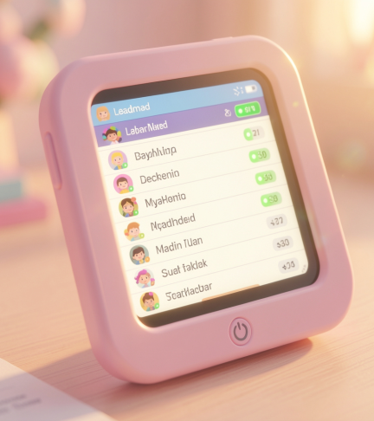
Leaderboard & UI

Slide 16
Persistent storage
Top 5 scores stored in EEPROM
Automatically updated after each game
Reset option available via button combination

Slide 17
Menu flow
LCD-based navigation:
Play
Leaderboard
Settings
States handled by State Machine
Includes:
Mode selection
Difficulty selection
Countdown before start

Slide 18
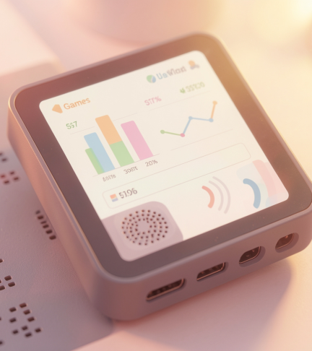
Feedback and analytics
Real-time feedback:
LEDs (visual)
Buzzer (audio)
System displays:
Scores during gameplay
Game status messages
Timeout system (5 seconds per move)

Slide 19
State Machine Design
System controlled using enum-based state machine:
Menu
Difficulty Select
Countdown
Playing
Success Wait
Game Over
Sleep
Ensures:
Smooth transitions
Non-blocking execution
Organized logic flow

Slide 20
Advanced Features
Functional Features
Difficulty scaling (LED speed decreases)
Timeout system (5 seconds per input)
Countdown before game start
Audio feedback system
Non-Functional Features
Debouncing (50 ms)
Non-blocking concurrency ( millis() )
Sleep mode after 2 minutes
Modular code structure

Slide 21
Conclusions
Successfully implemented a real-time embedded gaming system
Achieved:
High responsiveness
Clean UI experience
Reliable persistent storage
Demonstrates:
Embedded systems design
State machine architecture
Multi-mode game logic

Slide 22
Thank you!

